Slide 1


Taxing Times:
Implications of Tax Reform and Burgeoning Twin Deficits
May 2018
Mazen Issa
Senior FX Strategist
TD Securities

Slide 2
Key Points
Fiscal exceptionalism will be a major consideration going forward
Plugging the fiscal gap may be problematic
Tax reform has been good for share buybacks…
…but repatriation/BEAT exacerbate funding costs
More debt = higher rates!
Twin deficits = USD depreciation
A rotation away from the USD is underway
Recession risks: are we there yet?
Notes:
2

Slide 3
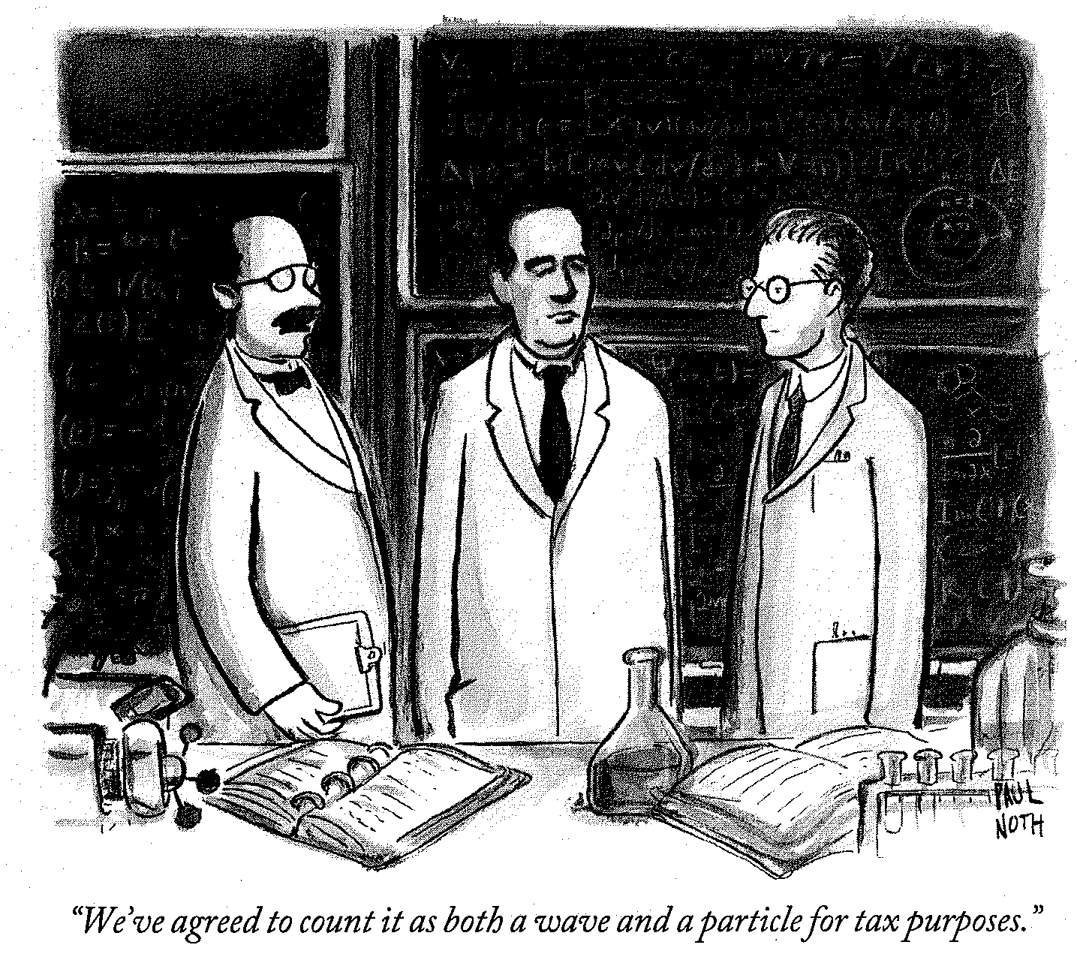
The Thing About Tax Reform
Notes:
3

Slide 4
Why You Should Care About Fiscal Exceptionalism
Notes:
4

Slide 5
Fiscal Stimulus in the Face of Strong Growth
Coupon and Bill Supply to Rise Sharply in 2019
Year | Deficit | Fed Runoff | Funding Need
2017 | 665 | 18 | 683
2018 | 800 | 175 | 975
2019 | 1136 | 284 | 1420
Source: CBO, Bloomberg, Treasury, TD Securities
Note: All years in fiscal years. All values in USD billion.
Notes:
5

Slide 6
Market May Be Losing a Buyer of Last Resort
Notes:
6

Slide 7
US Growth Projections: One of These is Not Like the Others
Notes:
7

Slide 8
Not All Spending is Treated Equally
Notes:
8

Slide 9
2005 Bush "Tax Holiday" Triggered Share Buybacks. This Time Is No Different
Notes:
9

Slide 10
Implications of Repatriation of Overseas Cash
Rates: Dollar funding pressure as less demand for dollar short term debt (higher Libor-OIS, wider cross currency basis)
Credit: Less corporate debt issuance
Notes:
10

Slide 11
BEAT Adds to Pressure on the Front End…
Notes:
11

Slide 12
…And Exacerbates Hit to Foreign Banks from Repatriation
Notes:
12

Slide 13
Twin Deficits Matter for the USD
Notes:
13

Slide 14
Tax Reform Will Likely Exacerbate Twin Deficits
?
Notes:
14

Slide 15
US Depends on the Kindness of Strangers
Notes:
15

Slide 16
Allure for Treasury Debt May Be Lost on Some Foreign Investors
Japan:
Notes:
16

Slide 17
(Capital) Rotation, Rotation, Rotation
Notes:
17

Slide 18
Central Bank Reserve Allocations to Add to the USD Headwind
Notes:
18

Slide 19
Central Bank Reserve Allocations On The Move
Notes:
19

Slide 20
Macro Convergence is Bad for the USD
Notes:
20

Slide 21
Higher Deficits Have Been Associated With Steeper Curves & Recessions
Notes:
21

Slide 22
The Ominous Yield Curve Flattening & Recession Signal
Notes:
22

Slide 23
Recession Risk: Warning Signs?
No two business cycles are quite the same; yet they all have much in common. They are not identical twins, but they are recognizable as belonging to the same family.
- Paul Samuelson
Notes:
23

Slide 24
Recession Risk: Changing Nature of Oil Shocks
Notes:
24

Slide 25
Recession Risk: Limited Real Over-investment
Notes:
25

Slide 26
Recession Risk: This Was an Unusually Deep and Long Recession
Notes:
26

Slide 27
Recession Risk: Trade War – No One Wants It, But Risk of Accident is High
Notes:
27

Slide 28
Recession Risk: Final Word
People stop buying things, and that is how you turn a slowdown into a recession.
- Janet Yellen
Notes:
28

Slide 29
Closing Thought: Fiscal Finances Coming to a Head
Notes:
29

Slide 30
Can Congress Get It Together?
Notes:
30

Slide 31
Can Congress Get It Together?
Notes:
31

Slide 32
Disclaimer
This material is for general informational purposes only and is not investment advice nor does it constitute an offer, recommendation or solicitation to buy or sell a particular financial instrument. It does not have regard to the specific investment objectives, financial situation, risk profile or the particular needs of any specific person who may receive this material. No representation is made that the information contained herein is accurate in all material respects, complete or up to date, or that it has been independently verified by TD Securities. Recipients of this analysis or report are to contact the representative in their local jurisdiction with regards to any matters or questions arising from, or in connection with, the analysis or report.
Historic information regarding performance is not indicative of future results and investors should understand that statements regarding future prospects may not be realized. All investments entail risk, including potential loss of principal invested. Performance analysis is based on certain assumptions, the results of which may vary significantly depending on the modeling inputs assumed. This material, including all opinions, estimates and other information, constitute TD Securities’ judgment as of the date hereof and is subject to change without notice. The price, value of and income from any of the securities mentioned in this material can fall as well as rise. Any market valuations contained herein are indicative values as of the time and date indicated. Such market valuations are believed to be reliable, but TD Securities does not warrant their completeness or accuracy. Different prices and/or valuations may be available elsewhere and TD Securities suggests that valuations from other sources be obtained for comparison purposes. Any price or valuation constitutes TD Securities’ judgment and is subject to change without notice. Actual quotations could differ subject to market conditions and other factors.
TD Securities disclaims any and all liability relating to the information herein, including without limitation any express or implied representations or warranties for, statements contained in, and omissions from, the information. TD Securities is not liable for any errors or omissions in such information or for any loss or damage suffered, directly or indirectly, from the use of this information. TD Securities may have effected or may effect transactions for its own account in the securities described herein. No proposed customer or counterparty relationship is intended or implied between TD Securities and a recipient of this document.
TD Securities makes no representation as to any tax, accounting, legal or regulatory issues. Investors should seek their own legal, financial and tax advice regarding the appropriateness of investing in any securities or pursuing any strategies discussed herein. Investors should also carefully consider any risks involved. Any transaction entered into is in reliance only upon the investor’s judgment as to financial, suitability and risk criteria. TD Securities does not hold itself out to be an advisor in these circumstances, nor do any of its representatives have the authority to do so.
The information contained herein is not intended for distribution to, or use by, any person in any jurisdiction where such distribution or use would be contrary to applicable law or regulation or which would subject TD Securities to additional licensing or registration requirements. It may not be copied, reproduced, posted, transmitted or redistributed in any without the prior written consent of TD Securities.
Australia: If you receive this document and you are domiciled in Australia, please note that this report is intended to be issued for general information purposes only and distributed through the Toronto Dominion Australia Limited (“TDAL”). TDAL does not hold itself out to be providing financial advice in these circumstances. TD Securities is a trademark and represents certain investment dealing and advisory activities of Toronto-Dominion Bank and its subsidiaries, including TDAL. The Toronto-Dominion Bank is not an authorized deposit-taking or financial services institution in Australia. TDAL is a holder of an Australian Financial Services License (404698) and is regulated by the Australian Securities and Investments Commission.
New Zealand: The Toronto-Dominion Bank is not a “registered bank” in New Zealand under the Reserve Bank Act 1989.
Canada: Canadian clients wishing to effect transactions in any security discussed herein should do so through a qualified salesperson of TD Securities or TD Securities Inc. TD Securities Inc. is a member of the Canadian Investor Protection Fund.
China, India and South Korea: Insofar as the document is received by any persons in the People's Republic of China (“PRC”) (which, for such purposes, does not include Hong Kong, Macau or Taiwan), India and South Korea, it is intended only to be issued to persons who have the relevant qualifications to engage in the investment activity mentioned in this document. The recipient is responsible for obtaining all relevant government regulatory approvals/licenses themselves, and represents and warrants to TD Bank that the recipient's investments in those securities do not violate any law or regulation, including, but not limited to, any relevant foreign exchange regulations and/or overseas investment regulations. The Toronto-Dominion Bank has a representative office in Shanghai, Mumbai and Seoul which should be contacted for any general enquiry related to The Toronto-Dominion Bank or its business. However, neither any of the Toronto-Dominion Bank offshore branches/subsidiaries nor its representative offices are permitted to conduct business within the borders of the PRC, India and South Korea. In locations in Asia where the Bank does not hold licenses to conduct business in financial services, it is not our intention to, and the information contained in this document should not be construed as, conducting any regulated financial activity, including dealing in, or the provision of advice in relation to, any regulated instrument or product. This publication is for general information only, without addressing any particular needs of any individual or entity, and should not be relied upon without obtaining specific advice in the context of specific circumstances.
Hong Kong: This document, which is intended to be issued in Hong Kong only to Professional Investors within the meaning of the Securities and Futures Ordinance (the "SFO") and the Securities and Futures (Professional Investor) Rules made under the SFO, has been distributed through The Toronto-Dominion Bank, Hong Kong Branch. The Toronto-Dominion Bank, Hong Kong Branch is regulated by the Hong Kong Monetary Authority.
Japan: For Japanese residents, please note that TD Securities is not licensed in Japan and this is being provided to qualified financial institutions (“QFI”) only under a relevant exemption to the Financial Instruments and Exchange Law.
If you have received this document from TD Securities (Japan) Co., Ltd., it is being provided only to institutional investors. TD Securities (Japan) Co., Ltd. is regulated by the Financial Services Agency of Japan and is distributing this document in Japan as a Type 1 Financial Instruments Business Operator registered with the Kanto Local Finance Bureau under registration number, Kinsho 2992, and a member of Japan Securities Dealers Association.
Singapore: This report is distributed in Singapore by The Toronto-Dominion Bank, Singapore Branch, and recipients in Singapore of this report are to contact The Toronto-Dominion Bank, Singapore Branch in respect of any matters arising from, or in connection with, this report. The Toronto-Dominion Bank, Singapore Branch is regulated by the Monetary Authority of Singapore. Where this report is issued or promulgated in Singapore, it is only intended for distribution to a person who is an accredited investor, expert investor or institutional investor (as defined in the applicable Singapore laws and regulations).
United Kingdom and Europe: This document is prepared, issued or approved for issuance in the UK and Europe by TD Securities Limited in respect of investment business as agent and introducer for TD Bank. The Toronto-Dominion Bank is authorised by the Prudential Regulation Authority and subject to regulation by the Financial Conduct Authority and limited regulation by the Prudential Regulation Authority. TD Securities Limited is authorised and regulated by the Financial Conduct Authority. Insofar as the document is issued in or to the United Kingdom or Europe, it is intended only to be issued to persons who (i) are persons falling within Article 19(5) ("Investment professional") of the Financial Services and Markets Act 2000 (Financial Promotion) Order 2005 (as amended, the "Financial Promotion Order"), (ii) are persons falling within Article 49(2)(a) to (d) ("High net worth companies, unincorporated associations, etc.") of the Financial Promotion Order, or (iii) are persons to whom an invitation or inducement to engage in investment activity (within the meaning of section 21 of the Financial Services and Markets Act 2000) in connection with the issue or sale of any securities may otherwise lawfully be communicated or caused to be communicated. European clients wishing to effect transactions in any security discussed herein should do so through a qualified salesperson of TD Securities Limited. Insofar as the information in this report is issued in the U.K. and Europe, it has been issued with the prior approval of TD Securities Limited.
United States: U.S. clients wishing to effect transactions in any security discussed herein must do so through a registered representative of TD Securities (USA) LLC. (a) the U.S. firm accepts responsibility for its contents, (b) persons receiving the report should effect transactions in securities discussed in the report through the U.S. firm, and (c) transactions in such securities by recipients of the report are actually effected only through the U.S. firm.
If you would like to unsubscribe from our email distribution lists at any time, please contact your TD Securities Sales Contact or email us at privacy.EAP@tdsecurities.com. You can access our Privacy Policy here (https://www.tdsecurities.com/tds/content/AU_PrivacyPage?language=en_CA&language=en_CA).
TD Securities is a trademark of the Toronto Dominion Bank and represents TD Securities Inc., TD Securities (USA) LLC and TD Securities Limited and certain investment and corporate banking activities of TD Bank and its subsidiaries.
© Copyright 2018 The Toronto-Dominion Bank. All rights reserved.

